Slide 1
PYHTON PROJECT
Cuisine & Location Insights

Slide 2
Premium Restaurant: Which cuisine and location combination is likely to ensure a restaurant maximizes the total revenue for itself (i.e. most people paying highest budget)?
2. Food Truck service: Food Trucks are mobile restaurants that serve low cost food out of the back of a Truck. The restaurateur wants to identify what cuisine is most affordable and the top 3 locations he should target with his Trucks.
3. Asian Fusion restaurant: An Asian restauranteur wants to identify which Asian cuisines she should offer in her Asian Kitchen, and where this Kitchen should be located if it is to target the most number of people open to Asian cuisine.
4. Alcohol company: A famous Alcohol company wants to increase sales of their alcohol brands. It wants to know what cuisine and locations it should target for its promotional activities.

Slide 3

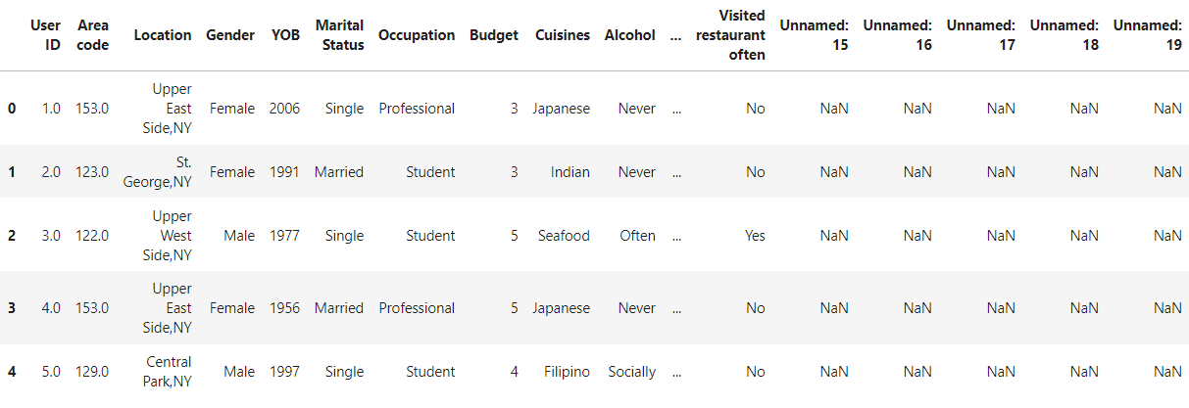
IMPORTING PACKAGES AND LOADING DATA.
import pandas as pd
import numpy as np
import plotly.express as px
data = pd.read_csv('Cuisine_Ratings.csv’)
data.head()

Slide 4
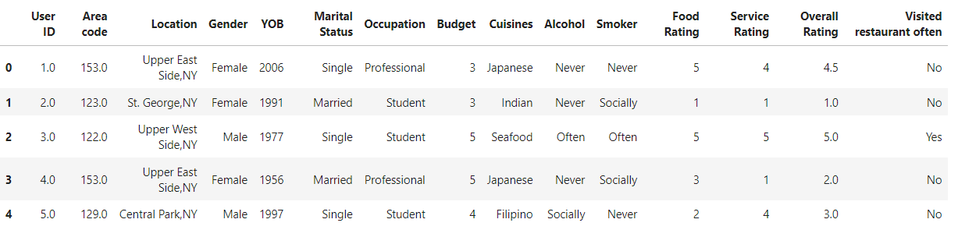
DROPPING NA AND NULL VALUES FROM DATA AND ALSO REMOVING EXTRA SPACES FROM DATA BY USING STRIP FUNCTION.
data = data.dropna()
data.columns= data.columns.str.strip()
data.head( )

Slide 5
REPLACING SIMILAR VALUES OF LOCATION BY MAPPING.
data[‘Location’].unique()
location_mapping = {'Central Park,ny':'Central Park,NY',
'Market City, MY': 'Market City, NY'}
data[‘Location’]= data[‘Location’].replace(location_mapping)
array(['Upper East Side,NY', 'St. George,NY', 'Upper West Side,NY’, 'Central Park,NY', 'China Town, NY', 'Riverdale,NY', 'Central Park,ny', 'Market City, NY', 'Market City, MY', 'Cedar Hill, NY'], dtype=object)

Slide 6
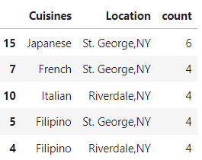
1. Premium Restaurant: Which cuisine and location combination is likely to ensure a restaurant maximizes the total revenue for itself (i.e. most people paying highest budget)?
High_budget = data[data[‘Budget’]== 5]
premium_restuarant = high_budget.groupby([‘Cuisines’,‘Location’]).size().reset_index(name = ‘count’)
premium_combinations = premium_restuarant.sort_values(by = ‘count’, ascending= False)
premium_combinations.head()

Slide 7
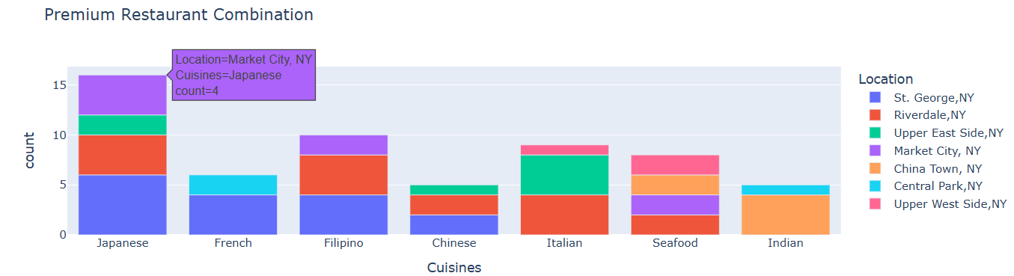
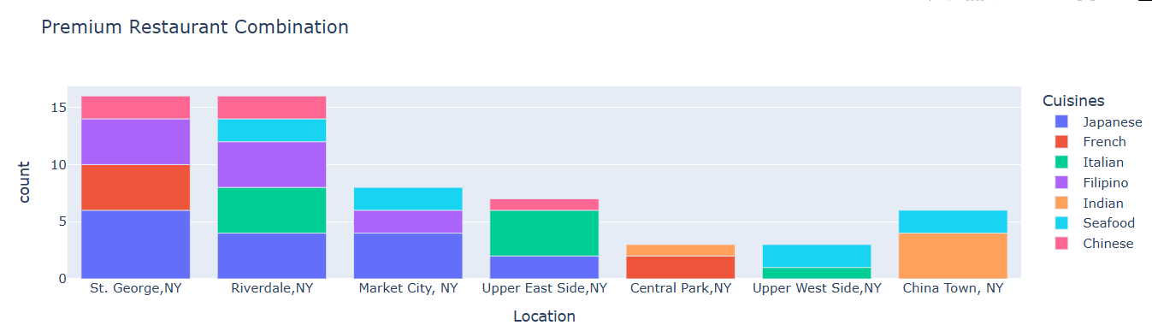
Fig1 =px.bar(premium_combination,x='Cuisines',y='count',color='Location',title='Premium Restaurant Combination', labels={'count':'count','Cuisines':'Cuisines’})
fig1.show()
Fig2 =px.bar(premium_combination,x='Location',y='count',color='Cuisines',title='Premium Restaurant Combination', labels={'count':'count','Cuisines':'Cuisines’})
fig1.show()

Slide 8
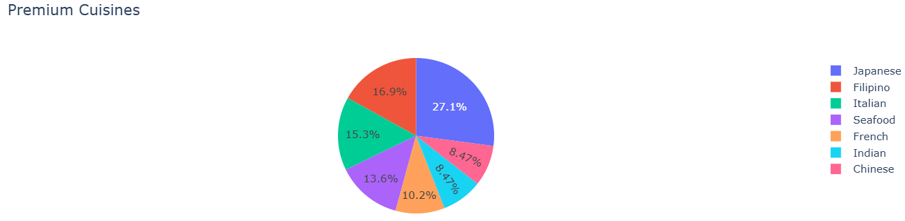
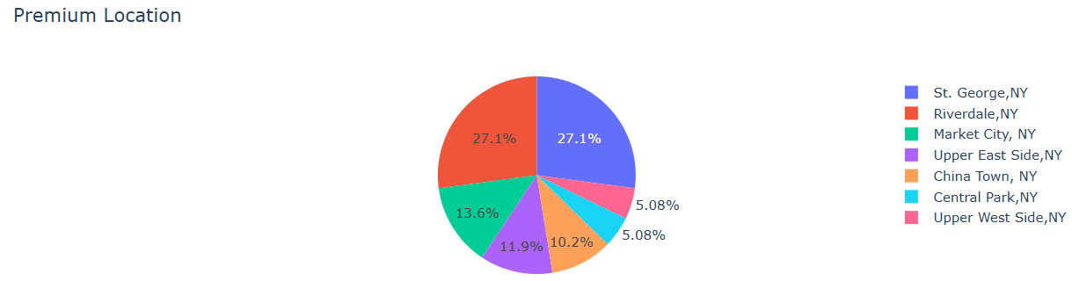
fig2 = px.pie(premium_combination,
names = ‘Cuisines’,
values = ‘count’,
title = 'Premium Cuisines’)
fig2.show()
fig2 = px.pie(premium_combination,
names = ‘Location’,
values = ‘count’,
title = 'Premium Cuisines’)
fig2.show()

Slide 9
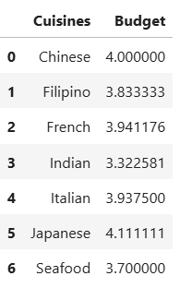

2. Food Truck service: Food Trucks are mobile restaurants that serve low cost food out of the back of a Truck. The restaurateur wants to identify what cuisine is most affordable and the top 3 locations he should target with his Trucks.
#calculating average budget for all the cuisines
#Calculating most affordable cuisine
avg_budget_cuisine = data.groupby('Cuisines')['Budget'].mean().reset_index()
avg_budget_cuisine
most_affordable_cuisine=avg_budget_cuisine.loc[avg_budget_cuisine['Budget'].idxmin()]
most_affordable_cuisine

Slide 10
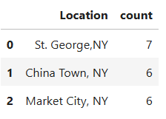
#identify the top 3 locations for the affordable cuisines
affordable_cuisine_data=data[data['Cuisines']==most_affordable_cuisine['Cuisines’]]
top_location=affordable_cuisine_data['Location'].value_counts().head(3).reset_index(name=‘count’)
top_location.columns=['Location','count']top_location

Slide 11
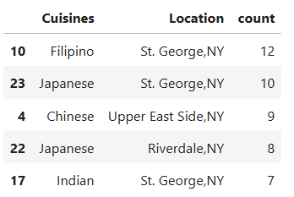
3. Asian Fusion restaurant: An Asian restauranteur wants to identify which Asian cuisines she should offer in her Asian Kitchen, and where this Kitchen should be located if it is to target the most number of people open to Asian cuisine.
#Filtering Asian cuisines from the data
#Calculating people open to asian cuisines by location
Asian_cuisines=data[data['Cuisines'].isin(['Japanese','Indian','Chinese','Filipino'])]
asian_cuisines_dist=Asian_cuisines.groupby(['Cuisines','Location']).size().reset_index(name='count’)
asian_cuisines_combination=asian_cuisines_dist.sort_values(by='count’,ascending=False)
asian_cuisines_combination.head()

Slide 12
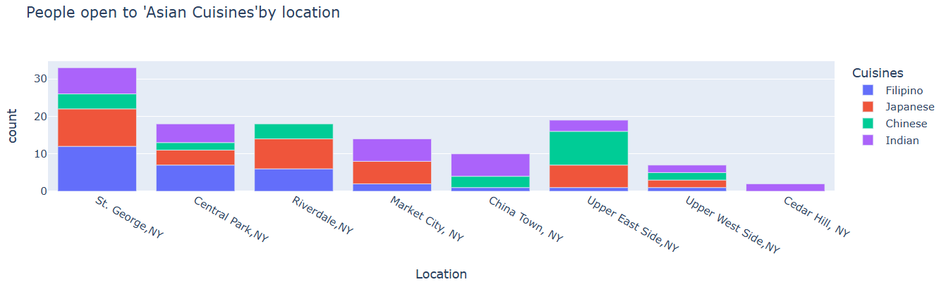
fig=px.bar(asian_cuisines_combination,x='Location',y='count',color='Cuisines',title="People open to 'Asian Cuisines'by location")
fig.update_layout(plot_bgcolor='sky Blue’)
fig.show()

Slide 13
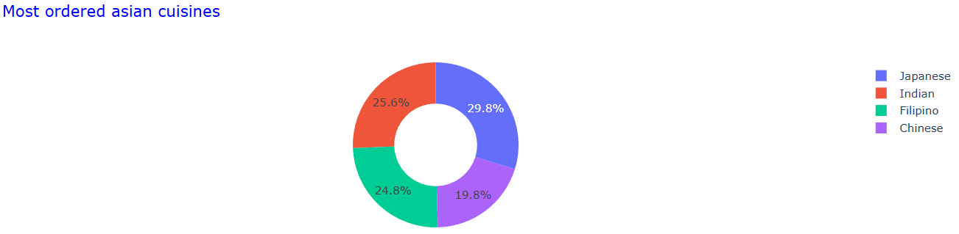
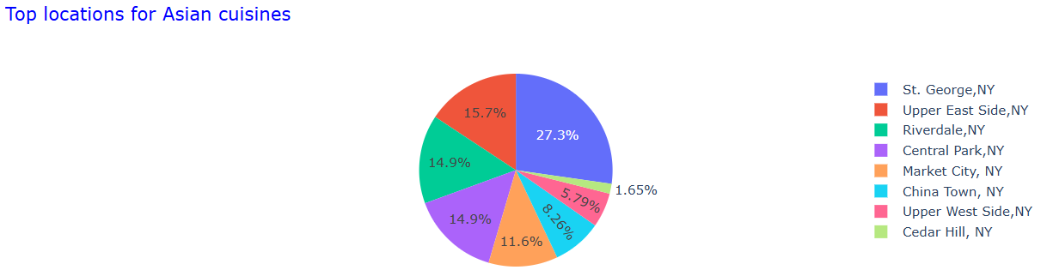
fig4=px.pie(asian_cuisines_combination,
values='count’,
names='Cuisines’,
title='Most ordered asian cuisines’,
hole= 0.5)
fig4.update_layout(title_font_color='Blue’)
fig4.show()
fig4=px.pie(asian_cuisines_combination,
values='count’,
names=‘Location’,
title=‘Top locations for Asian cuisines’,)
fig4.update_layout(title_font_color='Blue’)
fig4.show()

Slide 14
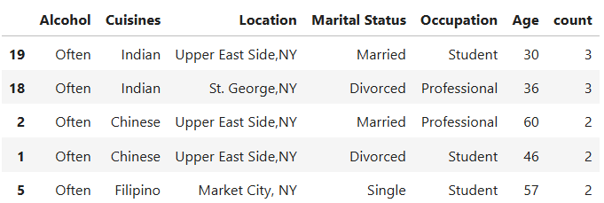
4. Alcohol company: A famous Alcohol company wants to increase sales of their alcohol brands. It wants to know what cuisine and locations it should target for its promotional activities.
# calculating and adding 'Age' column in data as per requirement
#filtering drikers based on their 'Cuisines prefference','Location','Marital status','Occupation' and 'Age'...
current_year = 2024
data['Age’]= current_year - data['YOB']
drinkers = data[data['Alcohol'].isin(['Often','Socially'])]
alcohol_distribution = drinkers.groupby(['Alcohol','Cuisines','Location','MaritalStatus','Occupation','Age']).size().reset_index(name='count’)
alcohol_combo =alcohol_distribution.sort_values(by='count',ascending=False)
alcohol_combo.head()

Slide 15
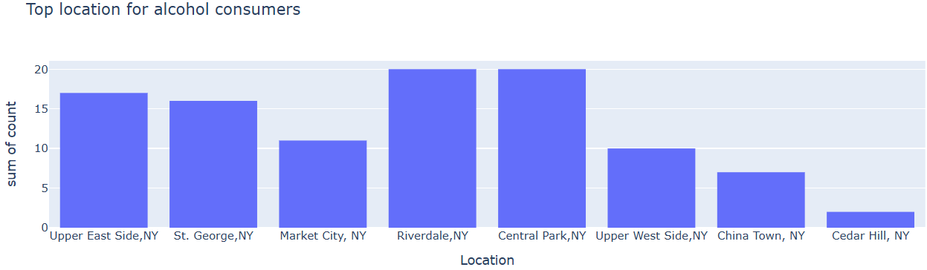
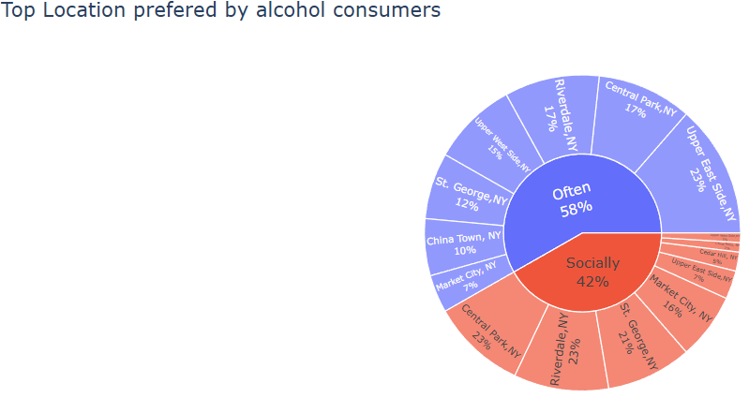
fig=px.histogram(alcohol_combo,x='Location',y='count',nbins=5,
title='Top location for alcohol consumers’)
fig.show()
fig=px.sunburst(alcohol_combo,
path=['Alcohol','Location’],
values='count’,
title="Top Location prefered by alcohol consumers")
fig.update_traces(textinfo='label+percent parent’)
fig.update_layout(height=450)
fig.show()

Slide 16
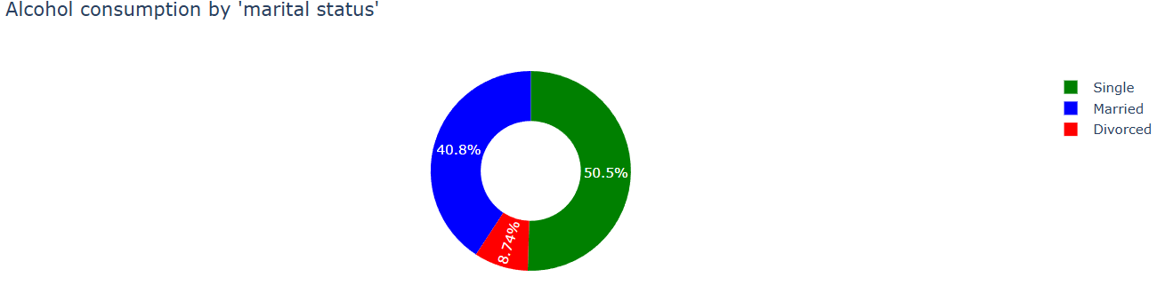
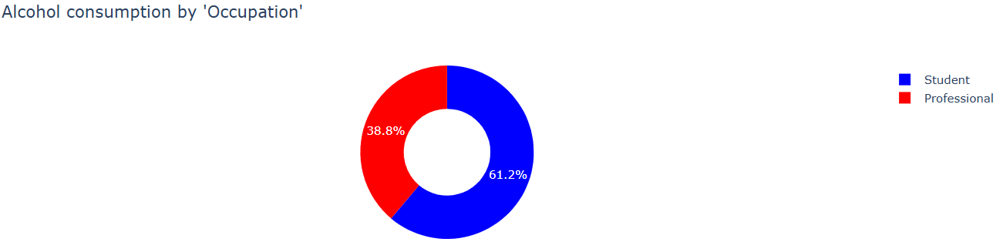
fig=px.pie(alcohol_combo,
names='Marital Status’,
values='count’,
title="Alcohol consumption by 'marital status’ ”,
color='Marital Status’,
hole=0.5,
color_discrete_map={'Divorced':'Red','Single':'Green','Married':'Blue’})
fig.show()
fig=px.pie(alcohol_combo,
names='Occupation’,
values='count’,
title="Alcohol consumption by 'Occupation’ ",
hole=0.5,
color='Occupation’,
color_discrete_map={'Student':'Blue','Professional':'Red’})
fig.show()

Slide 17
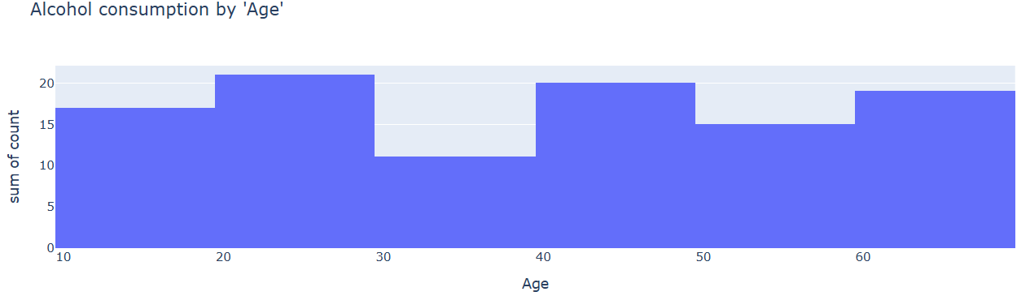
fig=px.histogram(alcohol_combo,
x='Age’,
y='count’,
nbins=10,
title="Alcohol consumption by 'Age’ ")
fig.show()

Slide 18
Thank You

